Slide 1
Donor Analytics

Slide 2
1,047,132 unique donors online and offline, since Jan 2009

Slide 3
Online dominated by Barack Obama.com

Slide 4
Number of multi-gift donors

Slide 5
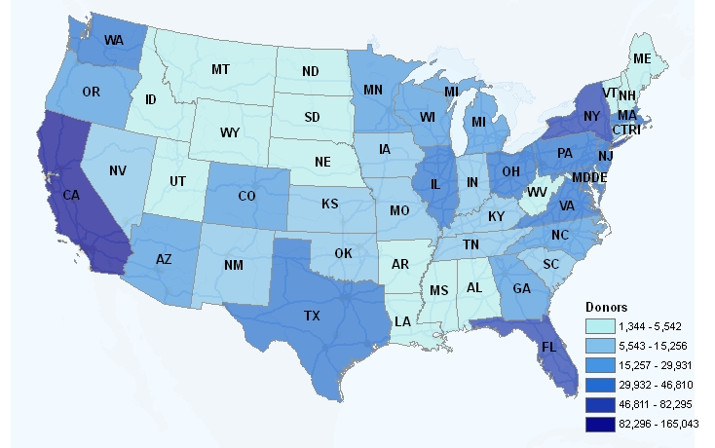
Geographic distribution of all donors

